Slide 1

Ecommerce DEVELOPED USING SPRINGBOOT & ANGULAR
PROJECT MEMBERS: ARUNA BHARATHI MUTHU JEYA
GUIDED BY:
PROF: INDRAKKA MALI

Slide 2
CONTENTS
Introduction
ER Diagram
Working of Back-End
Working of Front-End
Annotations
APIs
Advantages
Software Requirement
Conclusion

Slide 3
INTRODUCTION
Our e-commerce project is a comprehensive platform designed to enhance online shopping experiences. It enables users to browse products, view details, manage their carts, and complete orders seamlessly. Built with Spring Boot for the backend and Angular for the frontend, the platform features user-friendly navigation, a dynamic home page, secure authentication, and efficient order management. This project showcases our ability to integrate modern technologies and create scalable, customer-focused digital solutions.

Slide 4
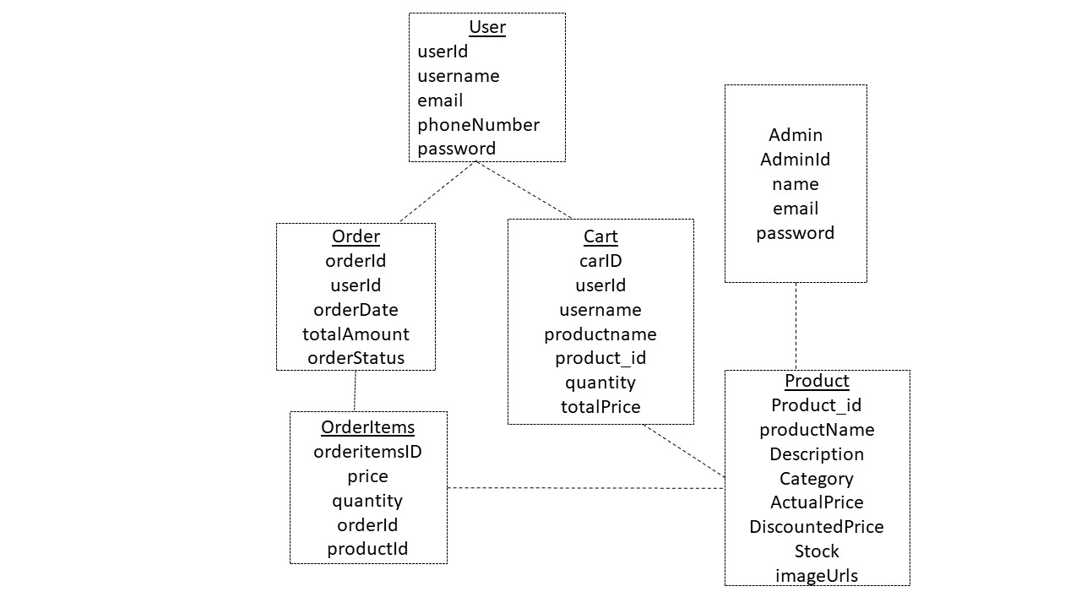
ER Diagram

Slide 5
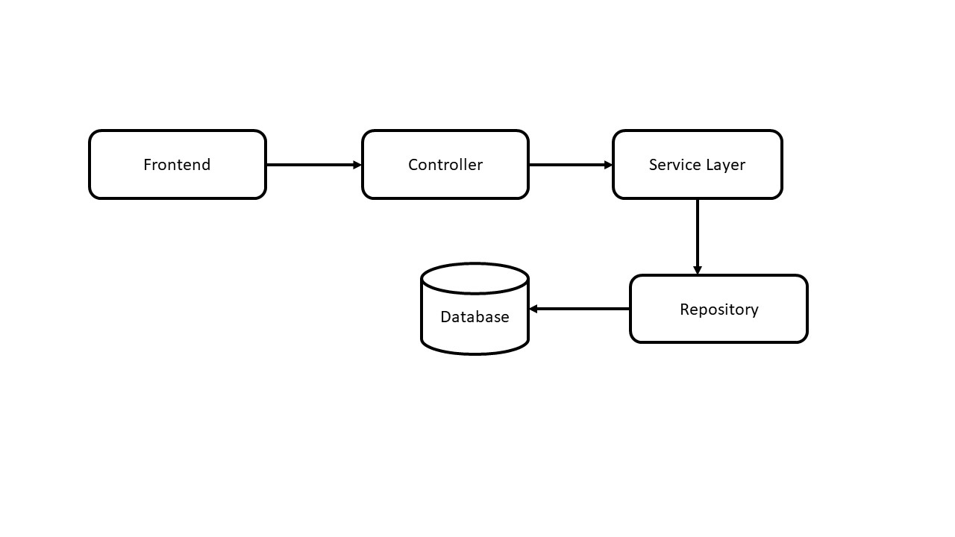
Working of Backend

Slide 6
Working of Frontend
The frontend of our e-commerce platform, developed using Angular, focuses on delivering a responsive and user-friendly shopping experience. The workflow includes:
User Interface Design
Routing and Component Interaction
Product Display and Interaction
Authentication
Data Management
Responsive Design

Slide 7
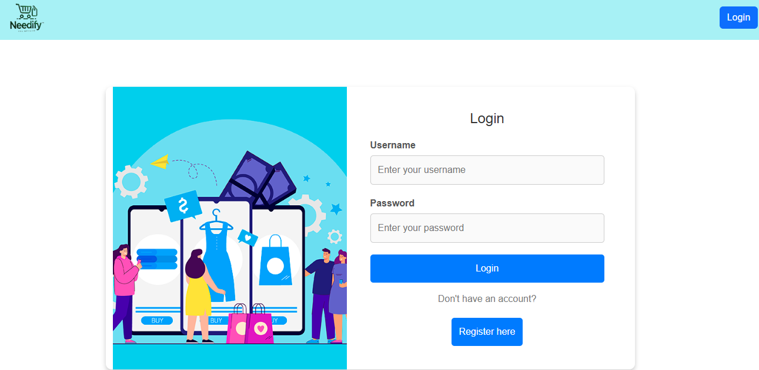
Login Page

Slide 8
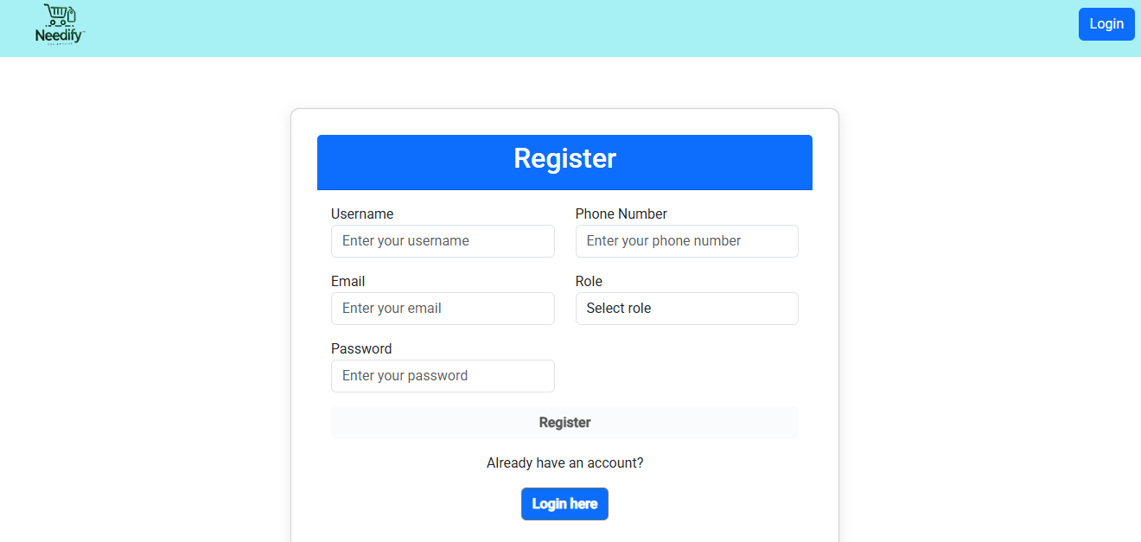
Registration Page:

Slide 9
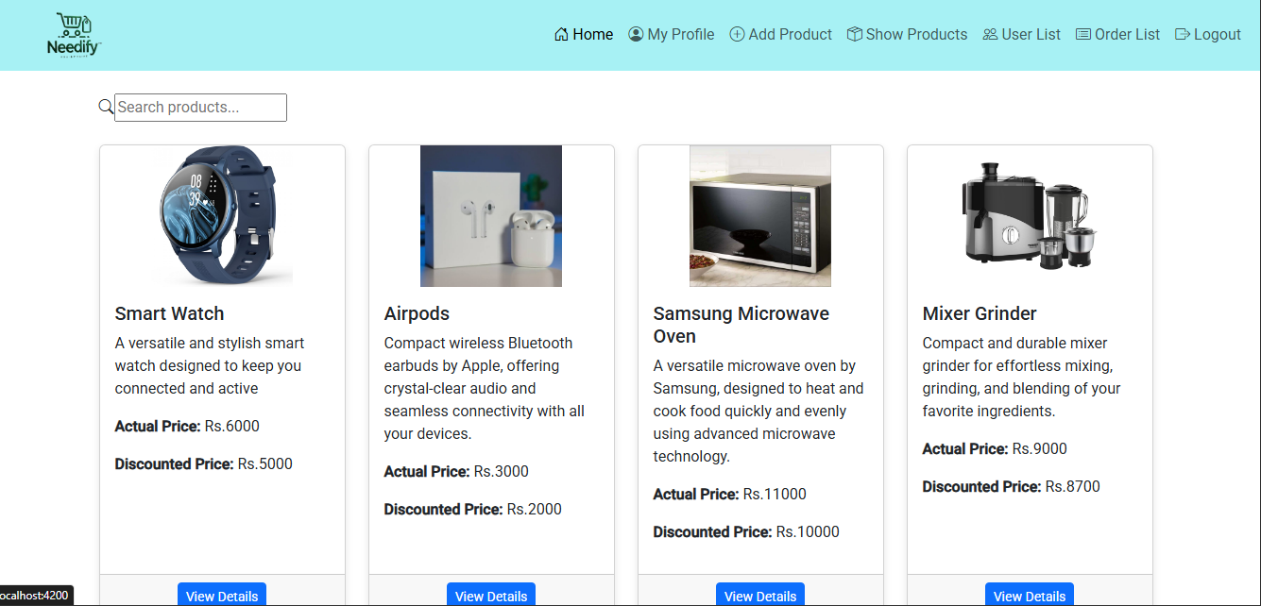
Home Page/Admin

Slide 10
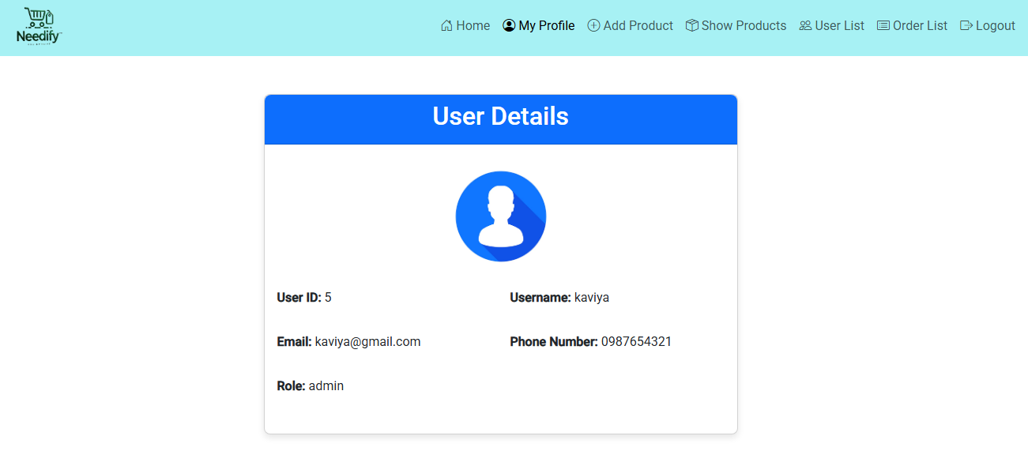
My Profile/Admin

Slide 11
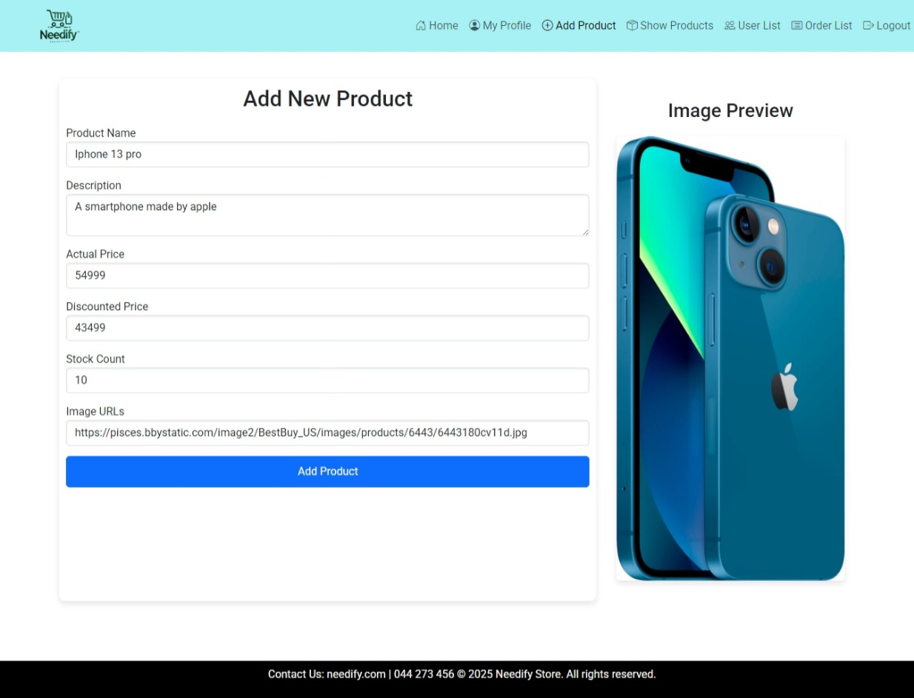
Add New Product

Slide 12
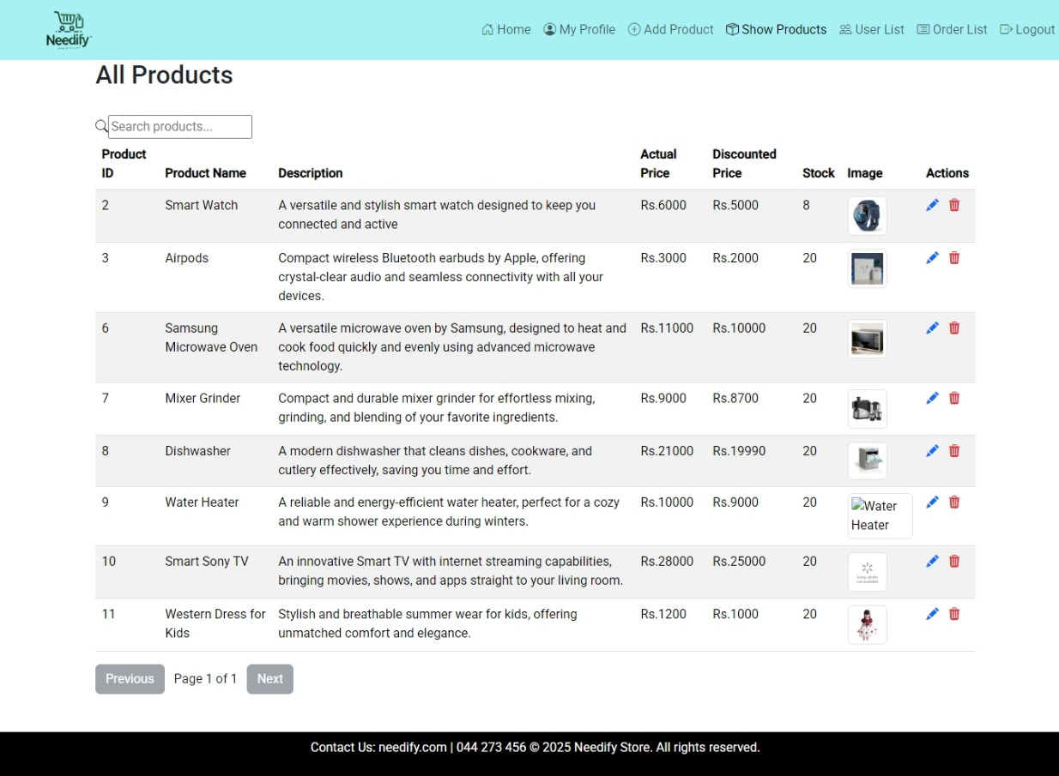
Show All Product

Slide 13
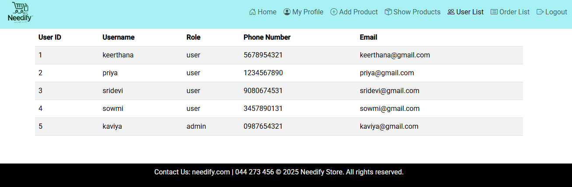
User list

Slide 14
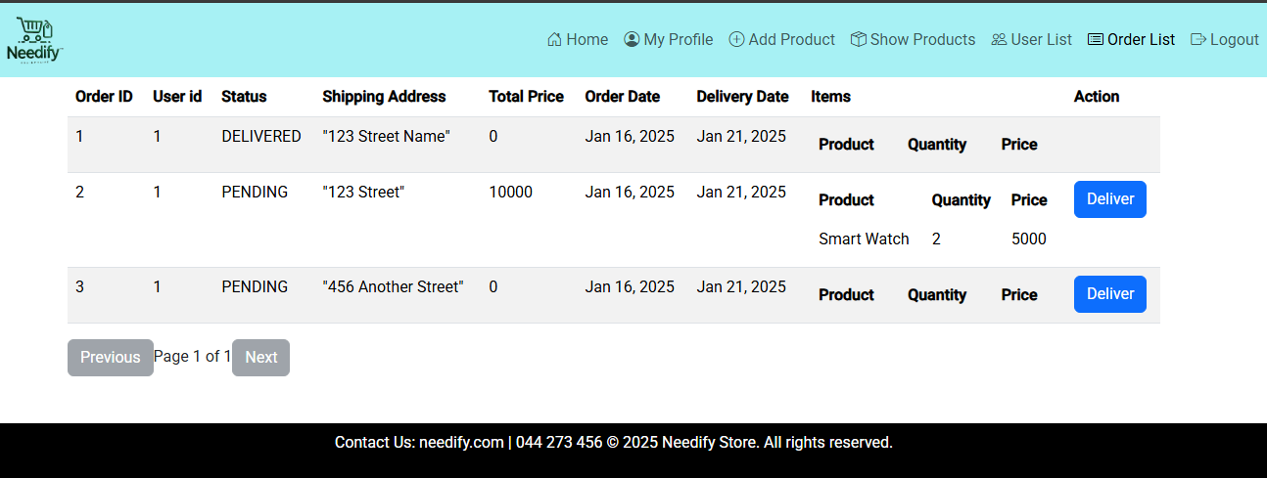
Order List

Slide 15
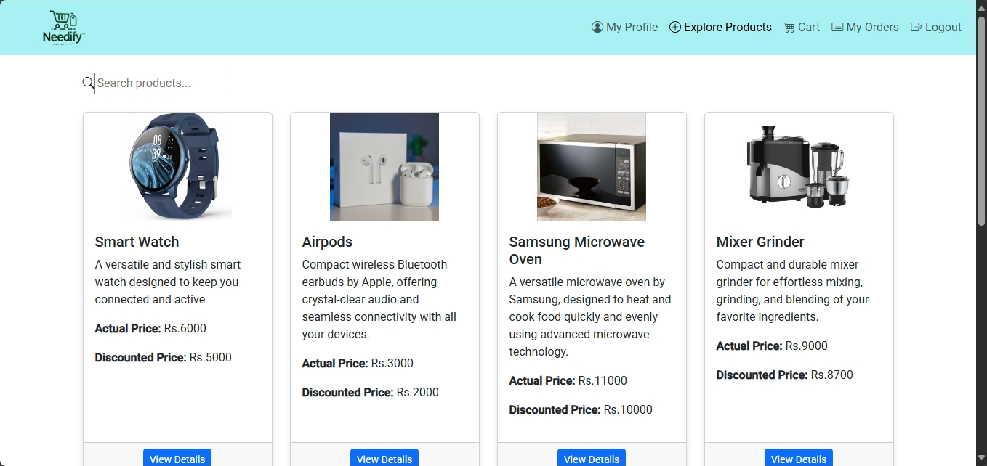
User Home Page

Slide 16
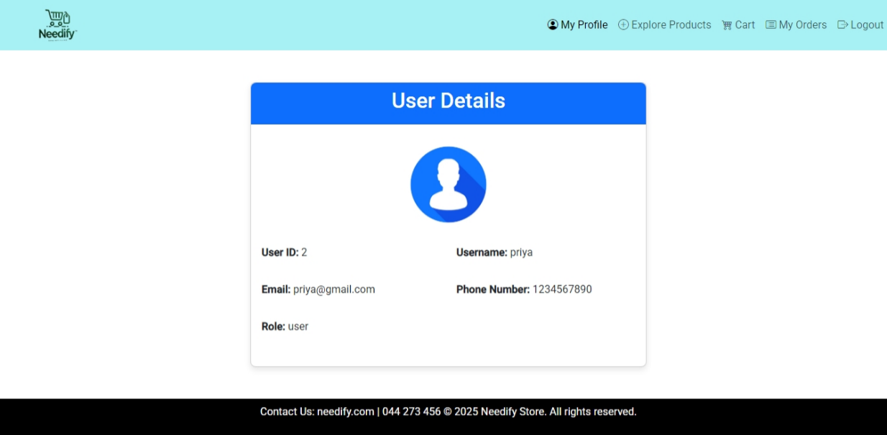
User Profile

Slide 17
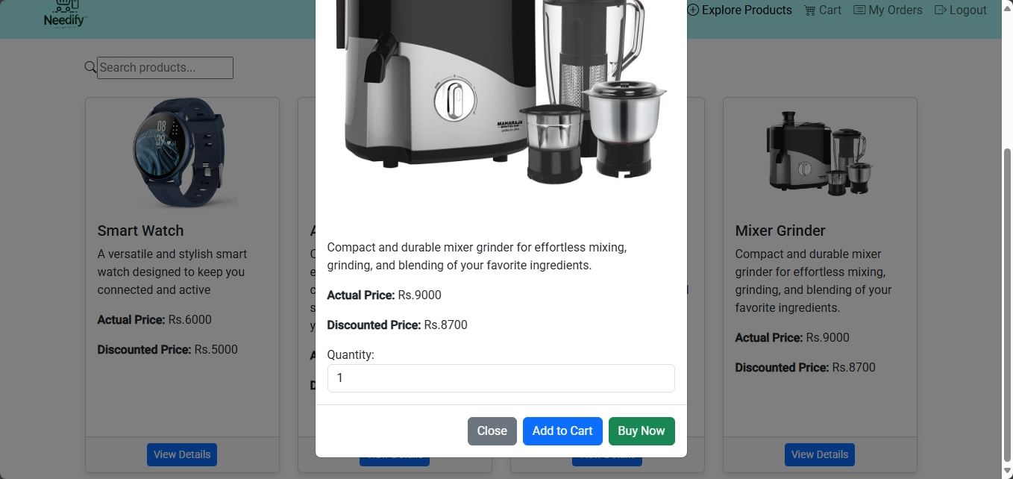
User Explore Product page

Slide 18
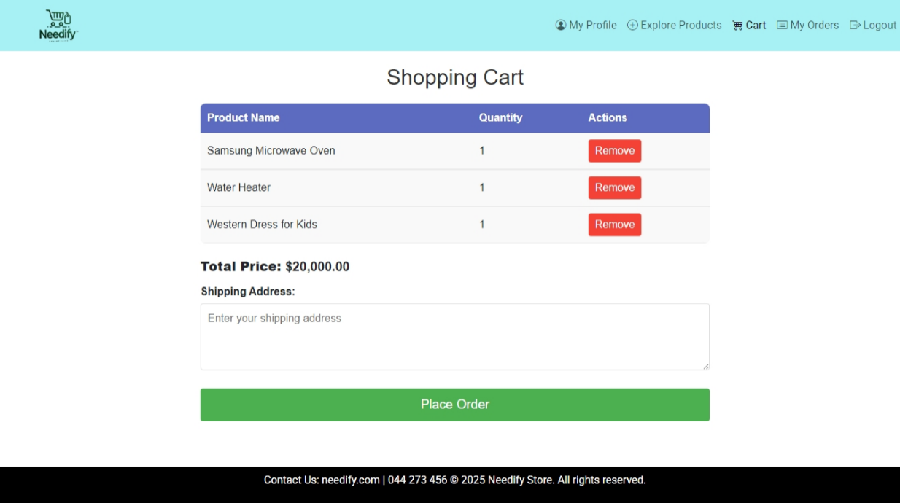
Cart Page

Slide 19
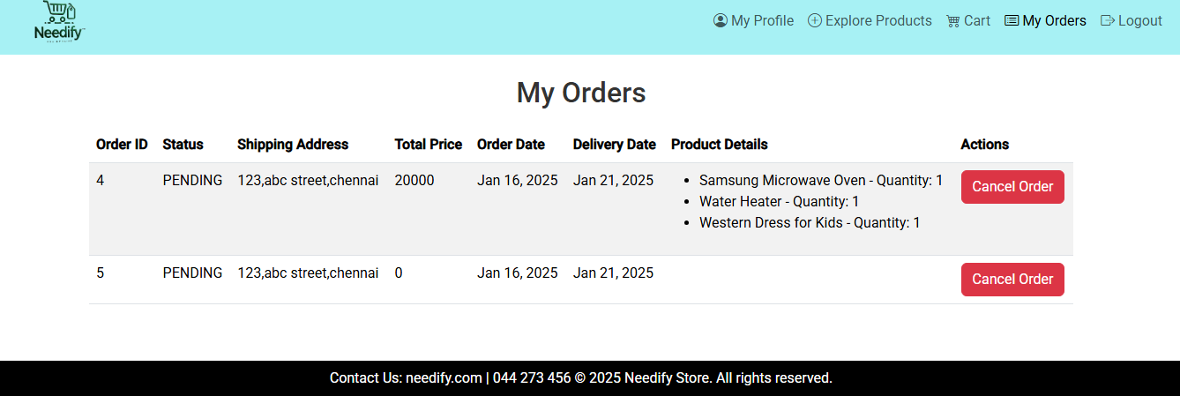
MY ORDER PAGE

Slide 20
Annotations
Annotations are metadata used in Spring Boot to provide configuration and behavior instructions to the application.
They simplify development by reducing boilerplate code and enhancing readability.
In our e-commerce project, commonly used annotations include:
Controller and Routing:
@RestController: Defines a class as a controller and returns JSON responses.
@RequestMapping and @GetMapping/@PostMapping: Map HTTP requests to specific methods.
Dependency Injection:
@Autowired: Injects dependencies like services and repositories automatically.
Entity Mapping:
@Entity: Defines a class as a database entity.
@Id and @GeneratedValue: Specify the primary key and its generation strategy.
@Column: Maps class attributes to database table columns.
Validation:
@NotNull, @Size, and @Email: Validate user inputs in form submissions.
Cross-Origin Resource Sharing:
@CrossOrigin: Enables cross-origin requests for frontend-backend communication.
Annotations make the application modular, easier to manage, and ensure adherence to the MVC architecture.

Slide 21
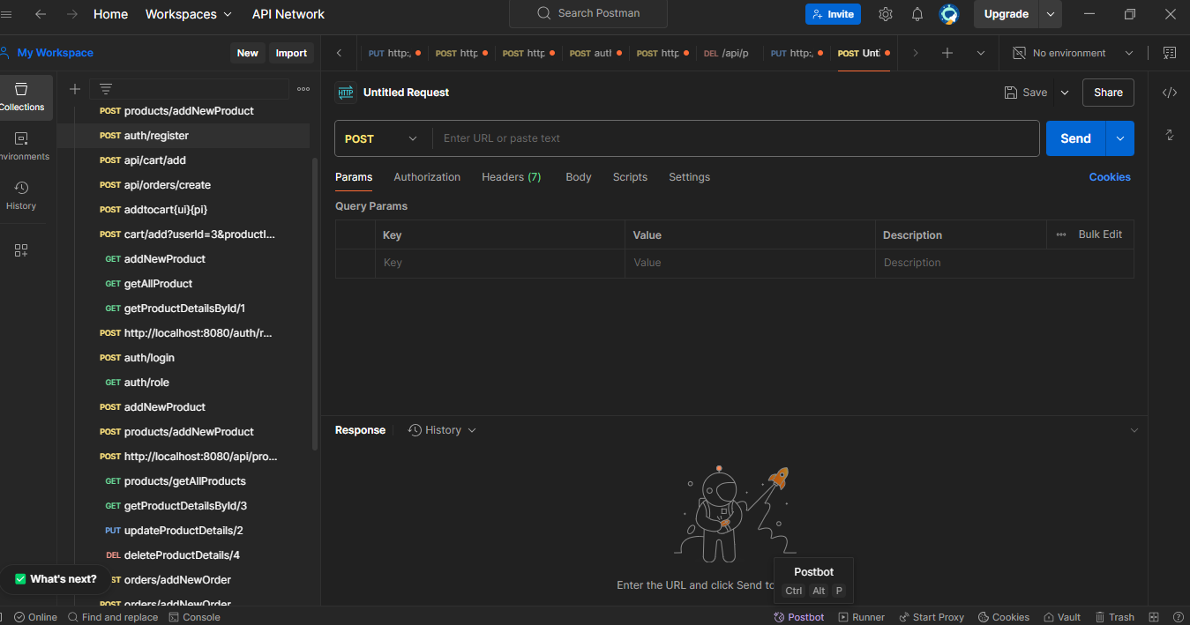
Postman

Slide 22
User APIs
Authentication:
POST /api/auth/register: User signup.
POST /api/auth/login: User login with JWT token generation.
User Management:
GET /api/users/{id}: Fetch user details.
PUT /api/users/{id}: Update user profile.
Cart Operations:
POST /api/cart/{userId}: Add items to cart.
GET /api/cart/{userId}: View cart items.
DELETE /api/cart/{userId}/{productId}: Remove cart item.
Order Management:
POST /api/orders/{userId}: Place an order.
GET /api/orders/{userId}: View orders.
These APIs enable secure, efficient user and cart interactions.

Slide 23
Product APIs
Fetch Products:
GET /api/products: Retrieve a list of all products.
GET /api/products/getProductDetailsById/{productId}: Get details of a specific product by its ID.
Add Products:
POST /api/products/addNewProduct: Add a new product (admin only).
Update Products:
PUT /api/products/updateProductDetails/{productId}: Update product details like name, price, or description (admin only).
Delete Products:
DELETE /api/products/deleteProductDetails{productId}: Remove a product from the catalog (admin only).
Search and Filter:
GET /api/products/search?query={keyword}: Search for products by name or description.
GET /api/products/filter?category={category}: Filter products by category.
These APIs ensure seamless management and retrieval of product information in the application.

Slide 24
Order APIs
Place an Order
POST /api/orders/{userId} //Create a new order for items in the user's cart.
Get Order Details
GET /api/orders/{orderId} //Retrieve detailed information for a specific order.
User Order History
GET /api/orders/user/{userId} //Fetch a list of all orders placed by a specific user.
Cancel an Order
DELETE /api/orders/{orderId} //Cancel an existing order (if applicable).
Admin Operations
GET /api/orders // View all orders (Admin only).
PUT /api/orders/{orderId}/status //Update the status of an order (e.g: “shipped”,”delivered”)

Slide 25
Cart APIs
Add Product to Cart POST /api/cart/add/{userId}/{productId} //Add a product to the cart with optional quantity.
Get Cart Items GET /api/cart/{userId} //Retrieve all items in the cart for a user.
Increase Product Quantity PUT /api/cart/increase/{userId}/{productId} //Increase the quantity of a product by 1.
Decrease Product Quantity PUT /api/cart/decrease/{userId}/{productId} //Decrease the quantity of a product by 1.
Remove Product from Cart DELETE /api/cart/remove/{userId}/{cartItemId} //Remove a product from the cart.
Get Total Price GET /api/cart/total/{userId} //Get the total price of items in the cart.
Clear Cart DELETE /api/cart/clear/{userId} //Clear all items from the cart.
Set Product Quantity PUT /api/cart/setQuantity/{userId}/{productId} //Set the quantity of a product in the cart.

Slide 26
Advantages
User-Centric Design
Provides a seamless and interactive interface for customers to browse, shop, and manage their accounts easily.
Enhanced Shopping Experience
Combines product variety, secure payment systems, and personalized recommendations for an enriched shopping experience.
Scalable Architecture
Designed to handle increased traffic and product inventory, ensuring growth without compromising performance.
Efficient Inventory and Order Management
Automated systems for real-time stock updates, order tracking, and management, reducing manual errors and improving operational efficiency.
Secure Transactions
Implements robust security measures for user data protection and secure payment processing.
Mobile Compatibility
Optimized for both desktop and mobile platforms, making it accessible to a wider audience.
Admin Control and Insights
Admins can manage products, orders, users, and generate reports for better decision-making and business insights.
Cost-Effective
Reduces operational costs with automation, eliminating manual tasks and improving resource management.

Slide 27
Software Requirements
Backend:
Java (Spring Boot) – For backend development.
MySQL/PostgreSQL – For storing product, user, and order data.
Frontend:
Angular – For building the website.
HTML, CSS, JavaScript – For designing and interactivity.
Development Tools:
Eclipse/IntelliJ IDEA – For Java development.
Visual Studio Code – For Angular development.
Postman – For API testing.
Testing:
Java Application – For manual testing of backend functionality.
Postman – For testing APIs.
Deployment:
Apache Tomcat – To run the Spring Boot app.
AWS/Heroku – For cloud hosting.
Security:
Spring Security – For user authentication.
JWT – For secure login sessions.

Slide 28
CONCLUSION
The e-commerce project provides a scalable platform for online shopping with a focus on user-friendly features and efficient backend management. Utilizing Spring Boot for the backend and Angular for the frontend, it ensures smooth functionality and a responsive, seamless shopping experience. The project includes automated order processing and real-time updates, designed to handle high traffic while maintaining a high level of customer satisfaction. With secure user authentication and thorough testing through Java applications, the project is built for reliability and performance, ensuring a dependable shopping platform.

Slide 29



